Slide 1
OBJECTIVE
Analyze and visualize stock market data using data science tools.
Collect and integrate both historical and real-time stock market data.
Clean, preprocess, and transform raw financial data into meaningful insights.
Apply statistical analysis and machine learning techniques to identify patterns, trends, and potential market movements.
Detect investment opportunities and assess market risks through analytical methods.
Develop interactive visualizations and dashboards for easy interpretation of financial data.
Present clear, intuitive representations of stock performance and predictive insights.
Enable investors and analysts to make informed, data-driven investment decisions.
Provide a user-friendly system that simplifies complex financial information.
Enhance market understanding and support strategic decision-making.

Slide 2
ABSTRACT
Market analysis is a crucial component for businesses to understand consumer behavior, identify trends, and make informed decisions. Traditional methods of analyzing market data are often manual, time_x0002_consuming, and lack the ability to process large volumes of dynamic data efficiently. With the emergence of data science, advanced tools can now transform raw data into meaningful insights in real time. The project “Smart Market Analysis and Visualization Using Data Science Tools” focuses on developing a system that leverages modern data science techniques to analyze market patterns, customer preferences, and competitive landscapes while presenting results through interactive visualizations. It emphasizes actionable insights, trend prediction, and decision support for business growth. Existing systems rely heavily on static reports, spreadsheets, and limited visualization techniques, which fail to capture real-time dynamics and provide predictive analysis. The proposed system integrates big data platforms with tools like Python, R, Tableau, and Power BI to enable dynamic dashboards, automated reporting, and AI-driven insights for smarter market decision-making. Algorithms such as Sentiment Analysis using NLP, Clustering with K-Means, Association Rule Mining, and Time Series Forecasting are applied to discover patterns, segment customers, and predict future market demands. This intelligent approach empowers organizations with data-driven strategies, improved competitiveness, and enhanced business outcomes.
Keywords: Market Analysis, Data Science, Data Visualization, Sentiment Analysis, Predictive Analytics, Business Intelligence, Customer Segmentation.

Slide 3
Existing System
Currently, stock market analysis is primarily performed using traditional financial tools, manual charts, and static reports provided by stock exchanges or financial platforms. Investors and analysts often rely on historical data tables, candlestick charts, and basic technical indicators to make trading decisions. While some platforms provide automated alerts or predictive models, most existing systems lack integration with advanced machine learning algorithms for accurate forecasting. Additionally, real-time visualization and interactive dashboards are either limited or not user-friendly, making it difficult to analyze multiple stocks, indicators, and trends simultaneously. As a result, existing solutions do not provide a comprehensive, data-driven approach that combines prediction, visualization, and real-time analysis in a single platform.

Slide 4
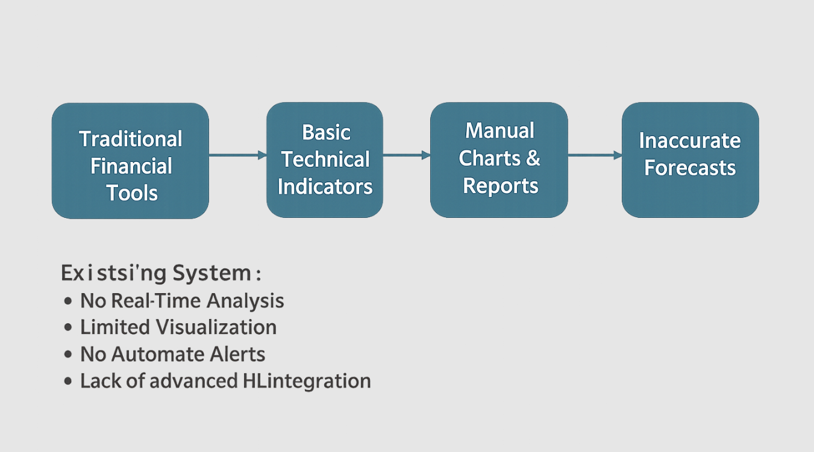

Slide 5
Proposed Methodology
Data Collection & Preprocessing: Collect historical and real-time stock market data from APIs (like Yahoo Finance, Alpha Vantage) and preprocess it by handling missing values, normalizing features, and generating technical indicators such as moving averages, RSI, and MACD.
Exploratory Data Analysis (EDA) & Visualization: Use data visualization tools (Matplotlib, Seaborn, Plotly) to identify patterns, correlations, and trends in stock prices. Interactive dashboards are created to provide insights into stock behavior over time.
Feature Engineering & Selection: Extract relevant features from historical data, including price changes, trading volume, and derived indicators, and select features that improve model accuracy.
Machine Learning / Deep Learning Modeling: Apply supervised learning models like Random Forest, SVM, XGBoost, and deep learning models like LSTM or ANN for time series forecasting and trend prediction. Train and validate models on historical data.

Slide 6
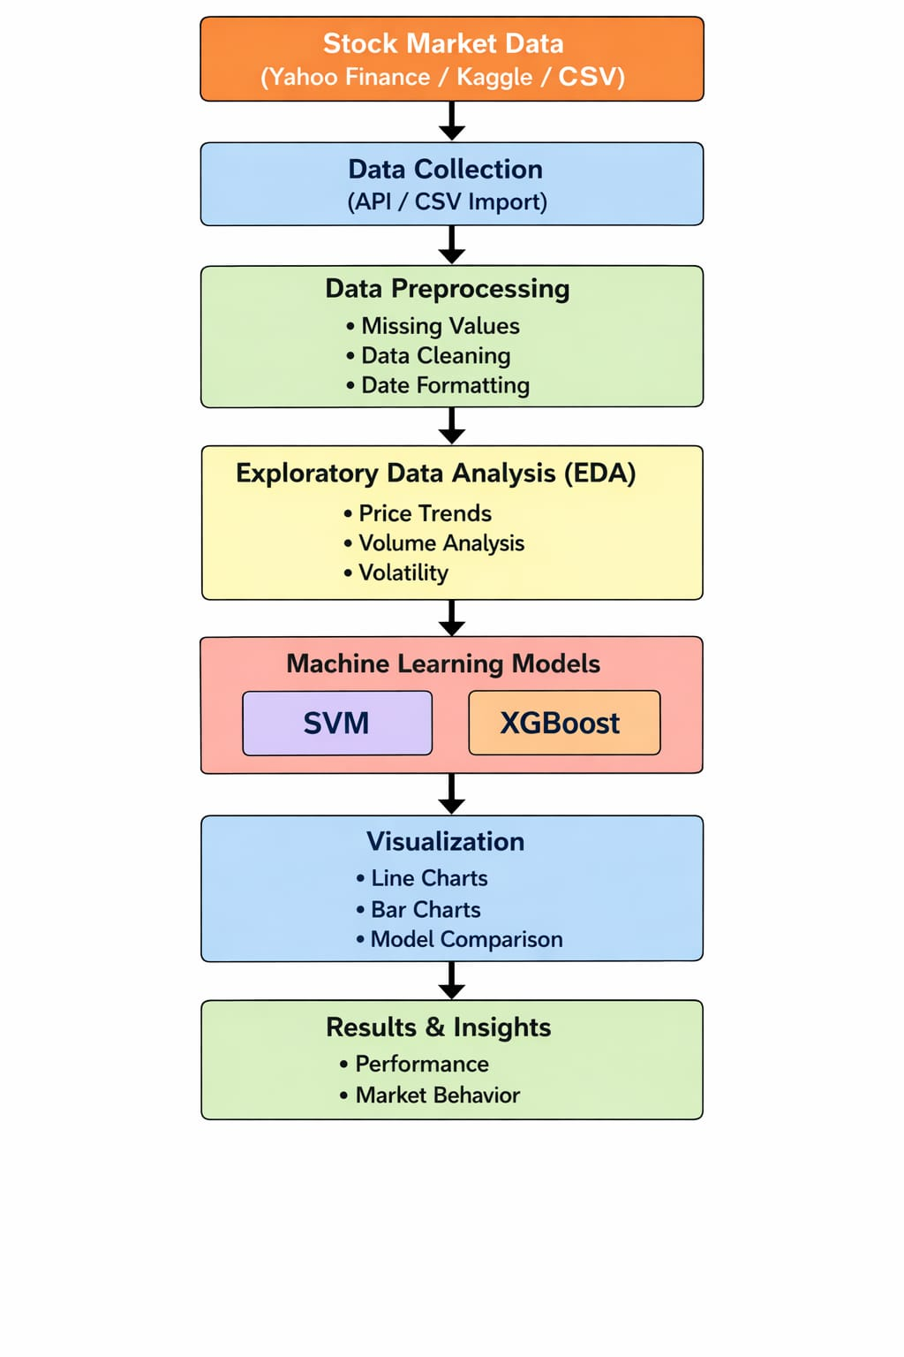
ARCHITECTURE DIAGRAM

Slide 7
ALGORITHM
XGBoost (Extreme Gradient Boosting)
XGBoost is an advanced ensemble machine learning algorithm based on gradient boosting. It combines multiple weak models (decision trees) to create a strong predictive model.
How XGBoost Works (Brief):
Builds models sequentially
Each new tree corrects the errors of the previous one
Uses gradient descent to minimize prediction error
Includes regularization to avoid overfitting
Why XGBoost for Stock Market?
High accuracy and performance
Handles large datasets efficiently
Works well with complex and noisy stock data
Applications in Our Project:
Predict future stock prices
Improve prediction accuracy compared to traditional models

Slide 8
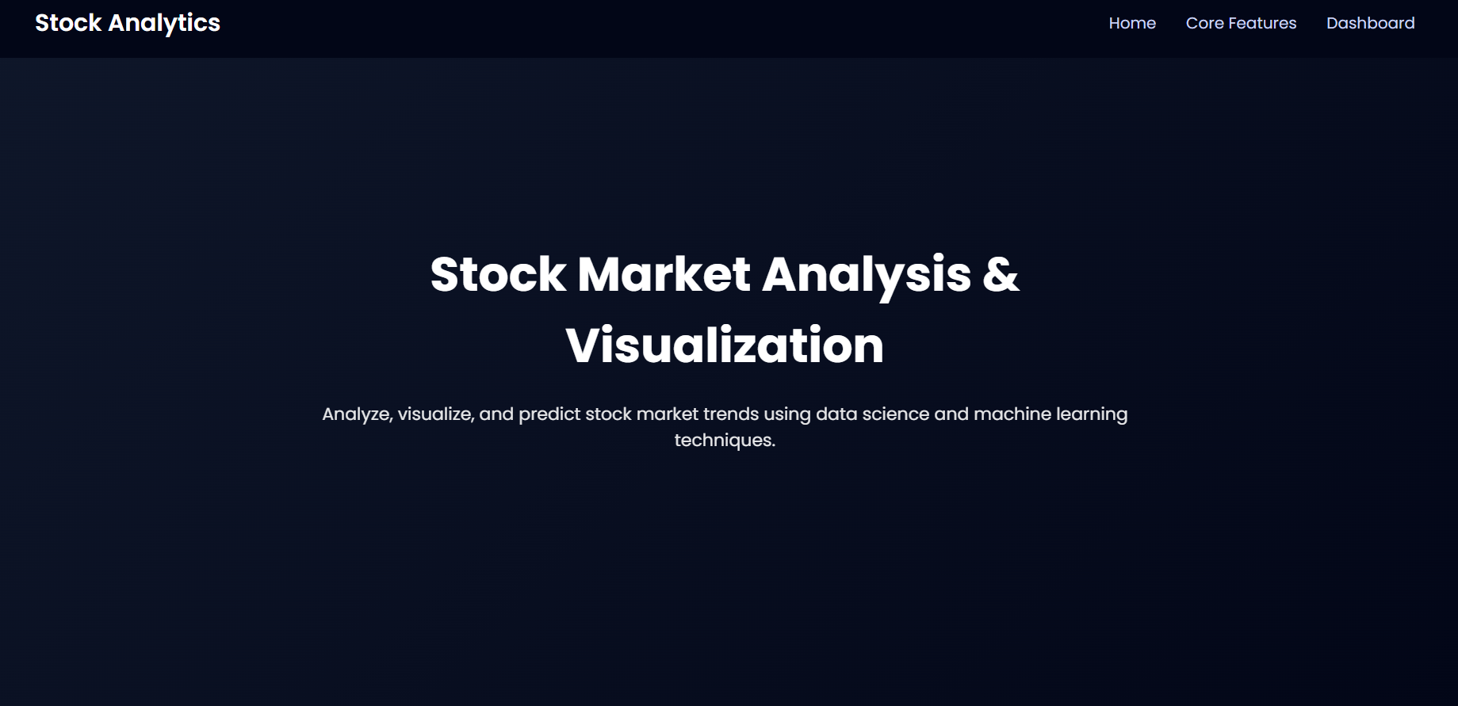
USER INTERFACE

Slide 9
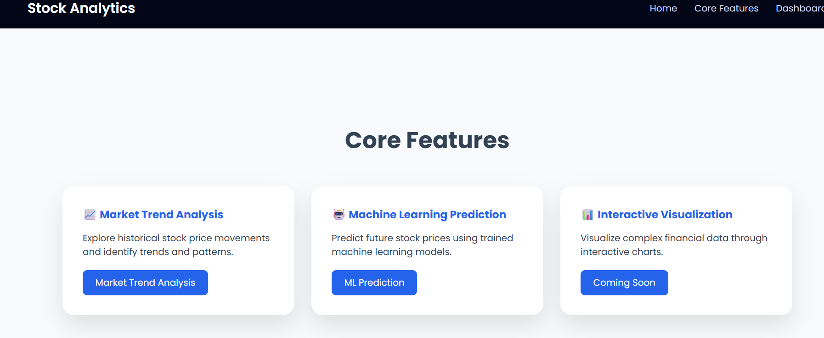
HOME PAGE

Slide 10
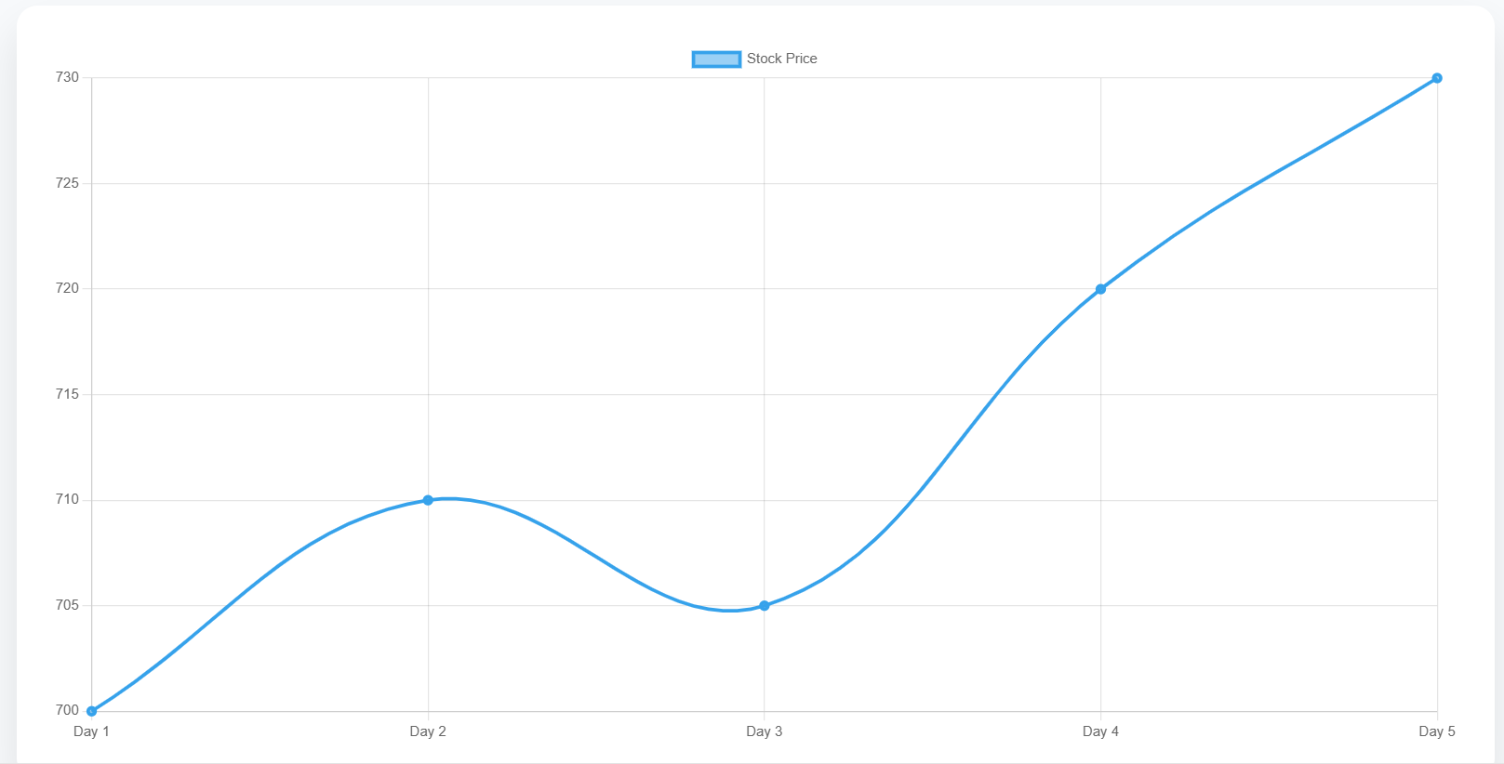
RESULTS :
TESLA STOCK MARKET TREND ANALYSIS

Slide 11
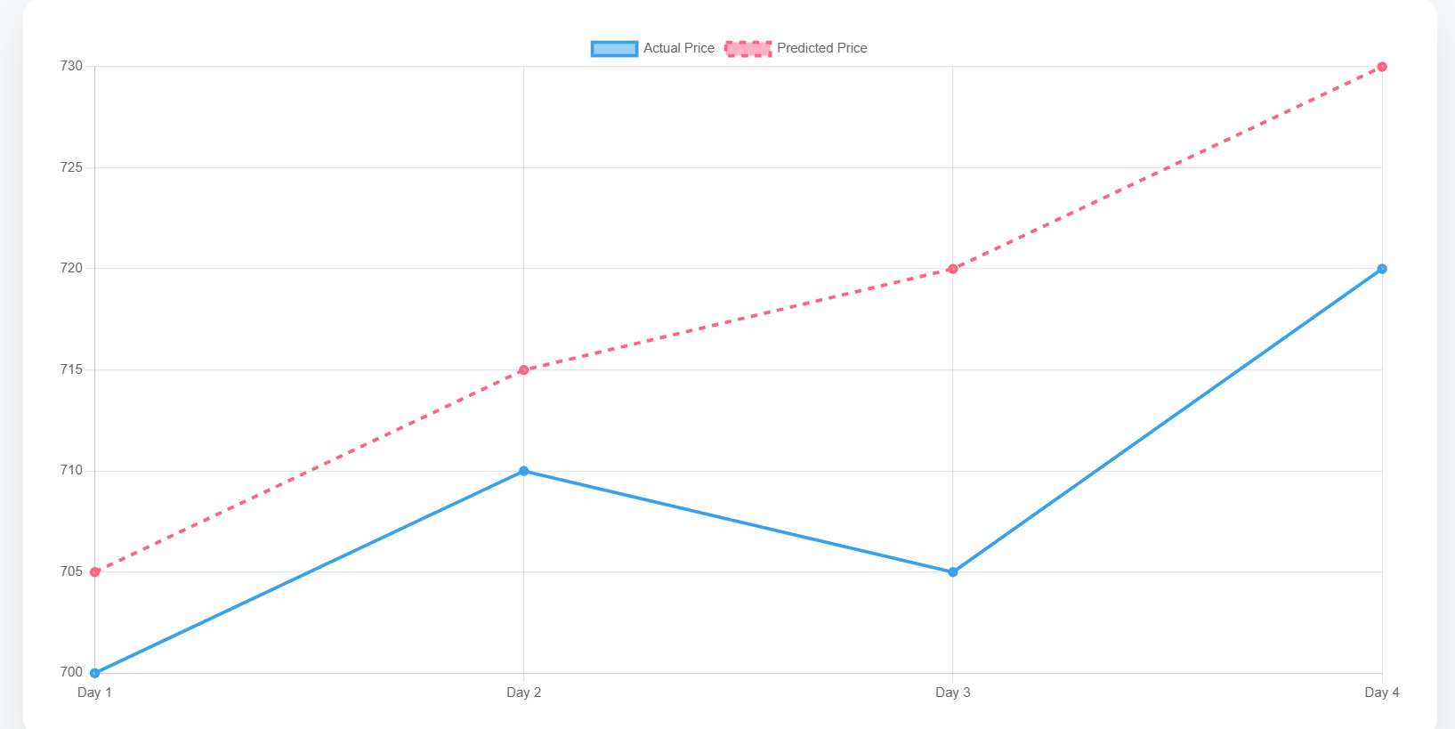
TESLA STOCK MACHINE LEARNING PREDICTION

Slide 12
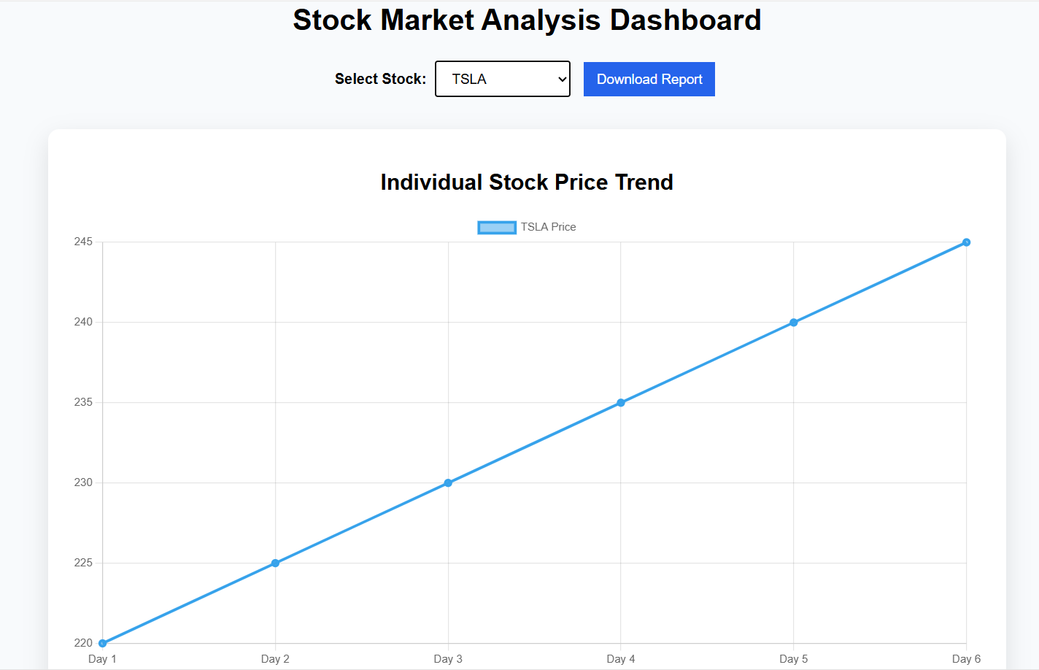
DASHBOARD

Slide 13
